Slide 1
Why the Public Library?
An art exhibition symbolizing why people seeking refuge and asylum use public libraries

Slide 2
Background
Libraries can provide support
But is the support effective?
Exhibition to show, not just tell, about lived experience and libraries

Slide 3
Exhibition Prompt
Create a piece of art that represents why you use the public library.
If the ways you use the public library have changed since you came to the UK, please also create a piece of art that represents why the ways you use the public library have changed.
You can submit as many photos and pieces of artwork as you like.

Slide 4
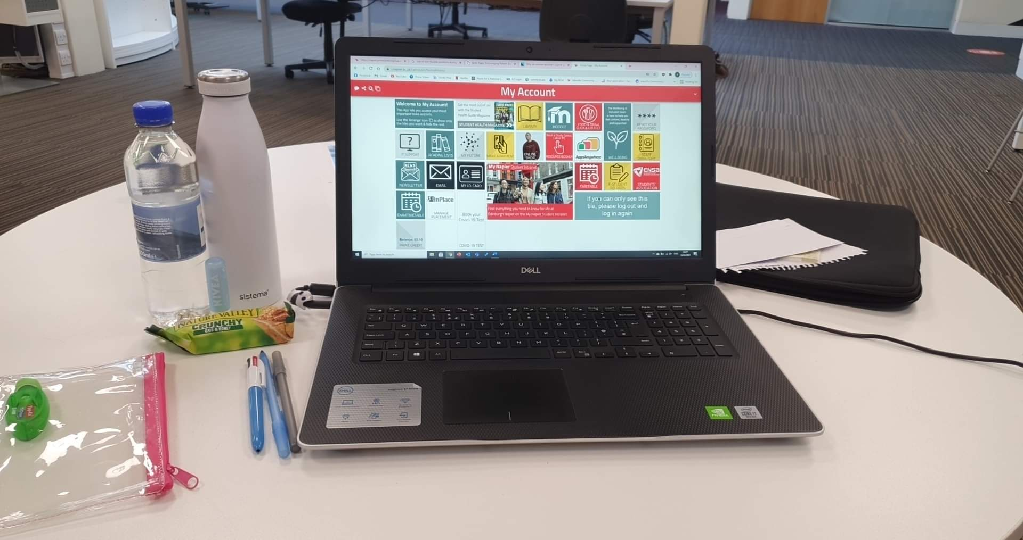
Example Art

Slide 5
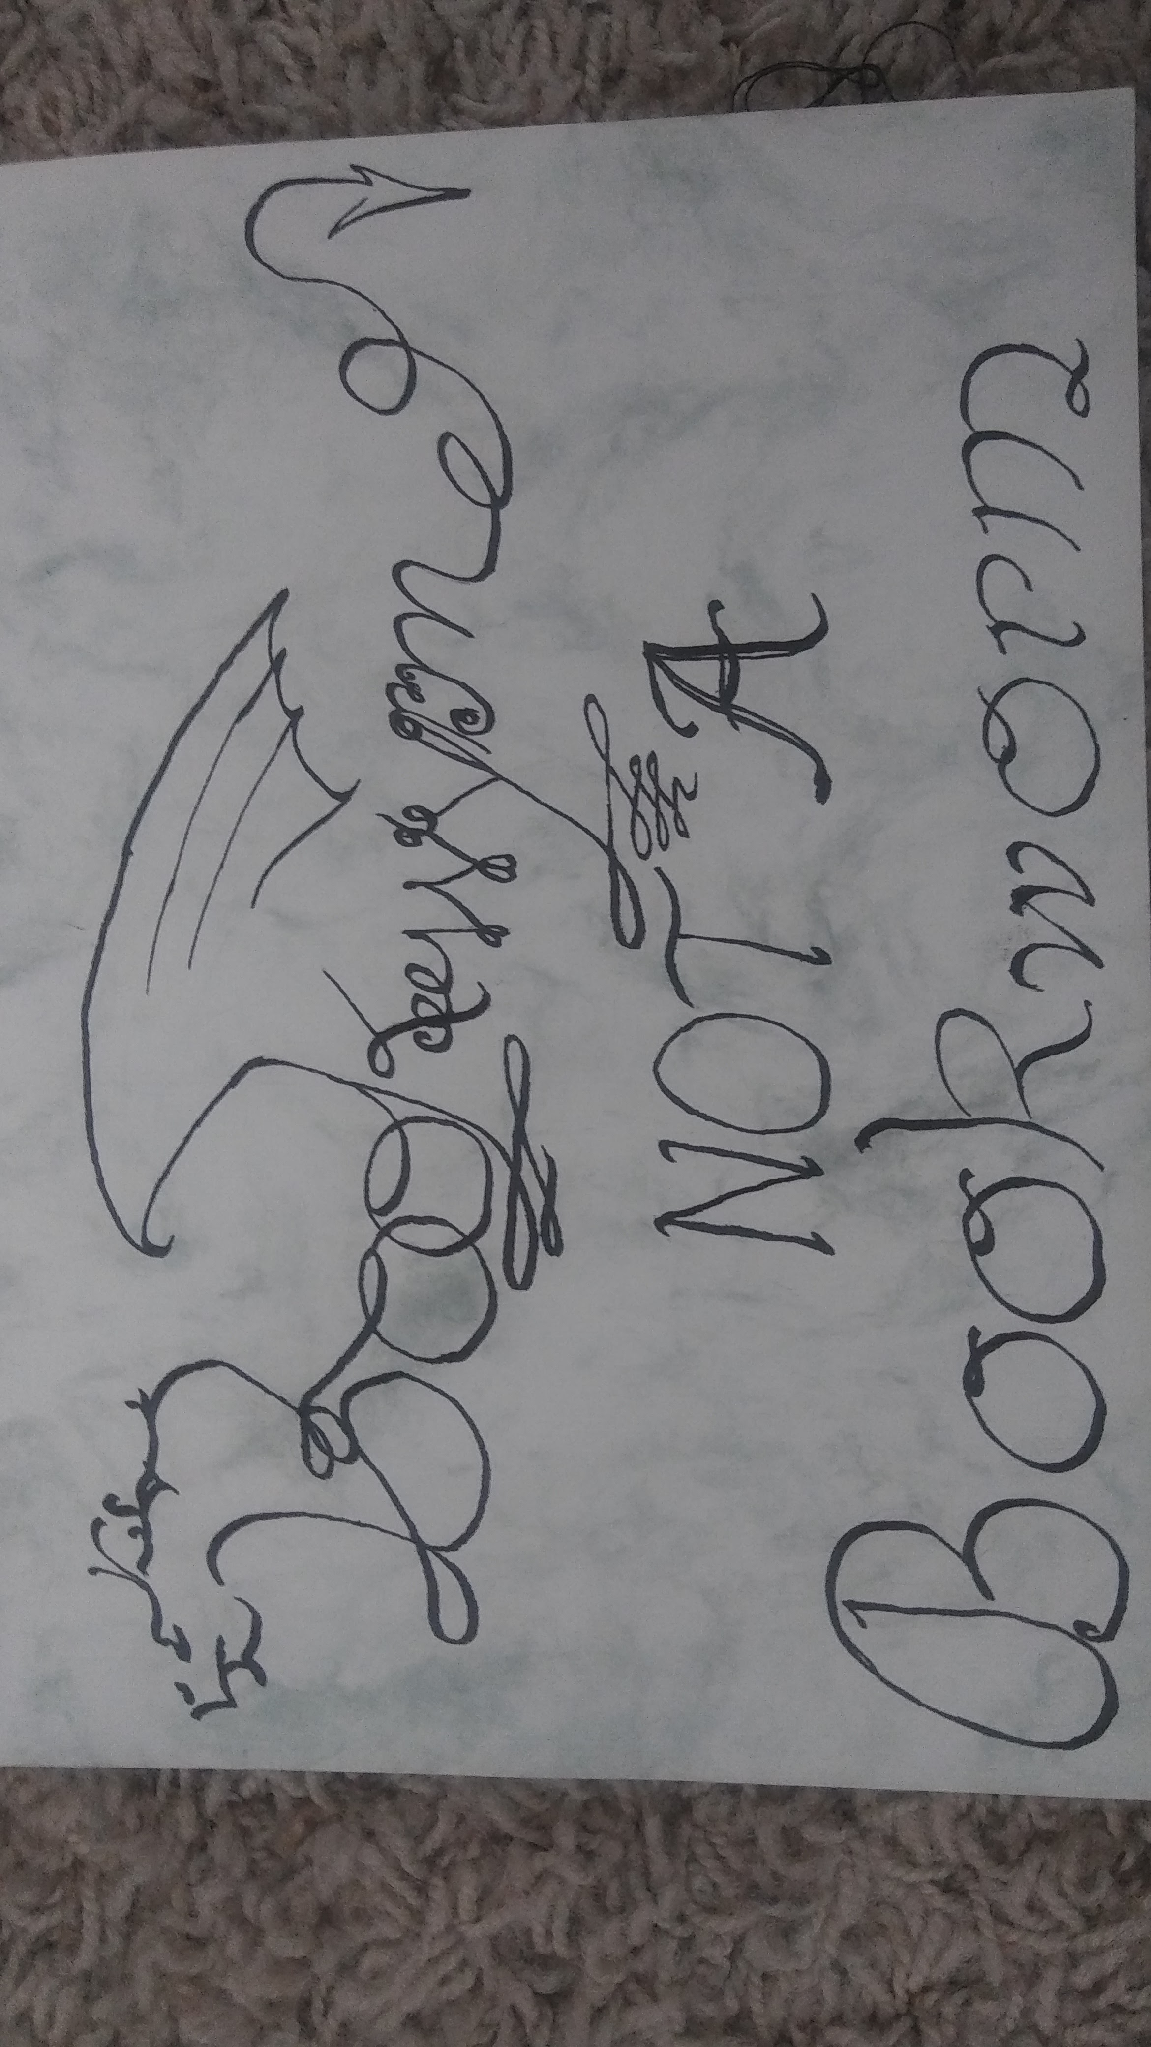
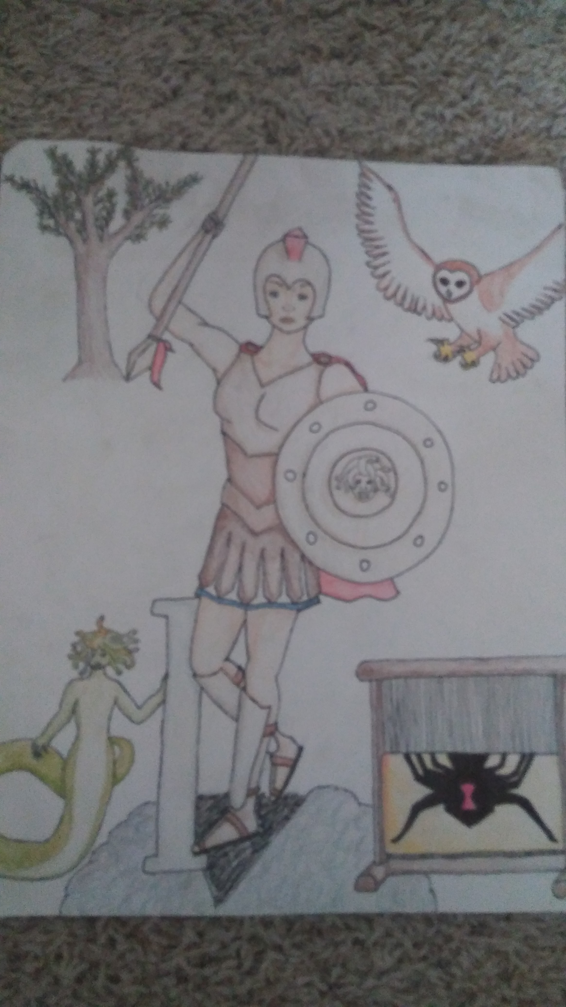
Example Art

